Slide 1

Reactive Agent-Based Traffic Control System
CO5 AT2 TECHNICAL PRESENTATION
CSA 1707 ARTIFICIAL INTELLIGENCE
Guided by
Dr Veeramani
Presented by:
Geferlin Boffy R- 192571080

Slide 2
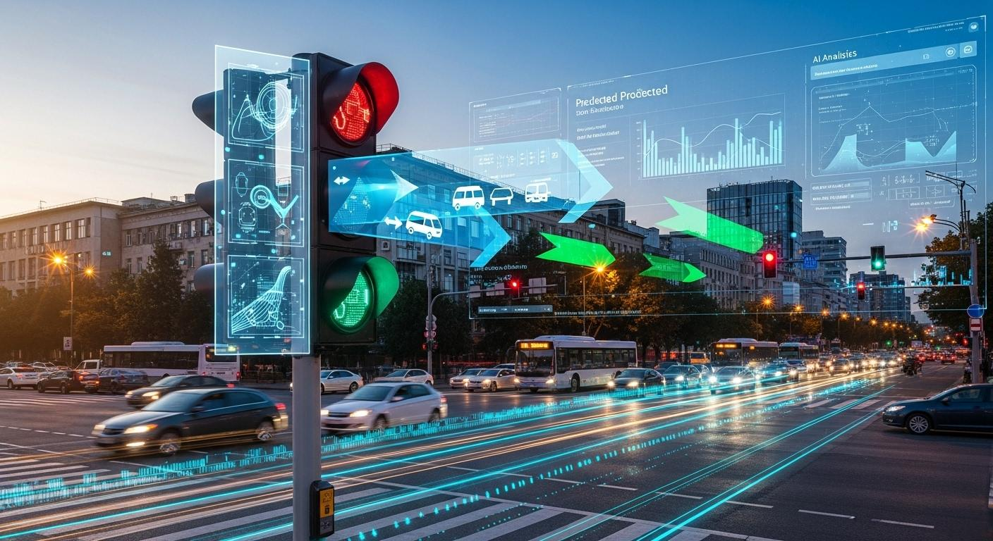
INTRODUCTION
Traditional traffic signals operate using fixed time intervals.
They cannot respond effectively to sudden changes in traffic density.
A Reactive Agent continuously observes the traffic environment.
It immediately responds to real-time traffic conditions.
The objective is to reduce congestion, waiting time, and unnecessary signal delays.

Slide 3
Problem Statement
Traditional traffic signal systems use fixed timings and cannot respond effectively to real-time changes in traffic density. This leads to traffic congestion, increased waiting time, fuel consumption, and inefficient road utilization. Therefore, a Reactive Agent-Based Traffic Control System is required to continuously process real-time traffic data and dynamically adjust signal timings to minimize congestion and improve traffic flow.

Slide 4
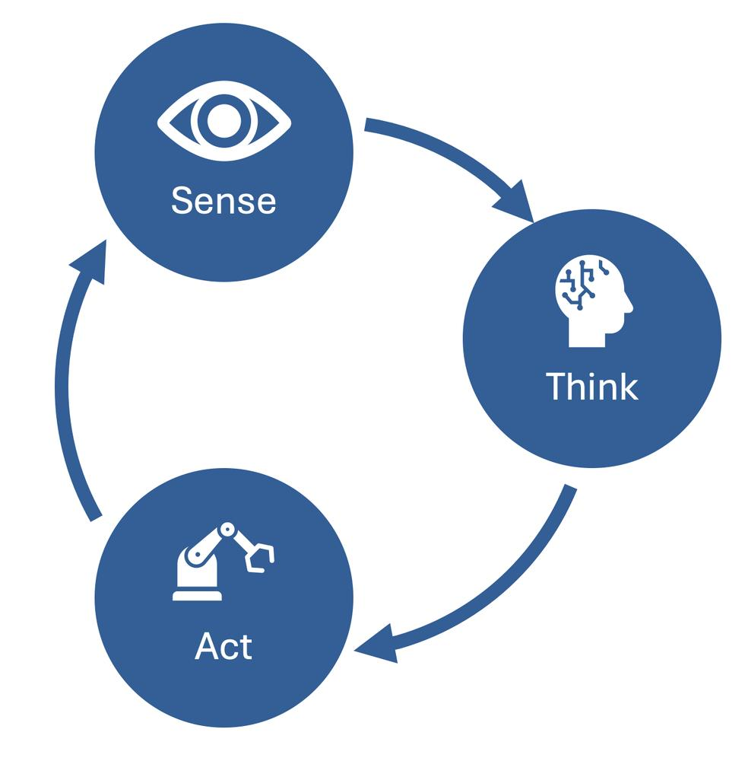
Reactive Agent
Example
IF traffic density is HIGH → THEN increase green-light duration.
IF traffic density is LOW → THEN reduce green-light duration.
IF emergency vehicle detected → THEN provide priority green signal.
A Reactive Agent is an AI agent that:
Perceives the current environment.
Processes incoming information.
Applies predefined condition-action rules.
Performs an immediate action.
Does not require long-term planning or memory.

Slide 5
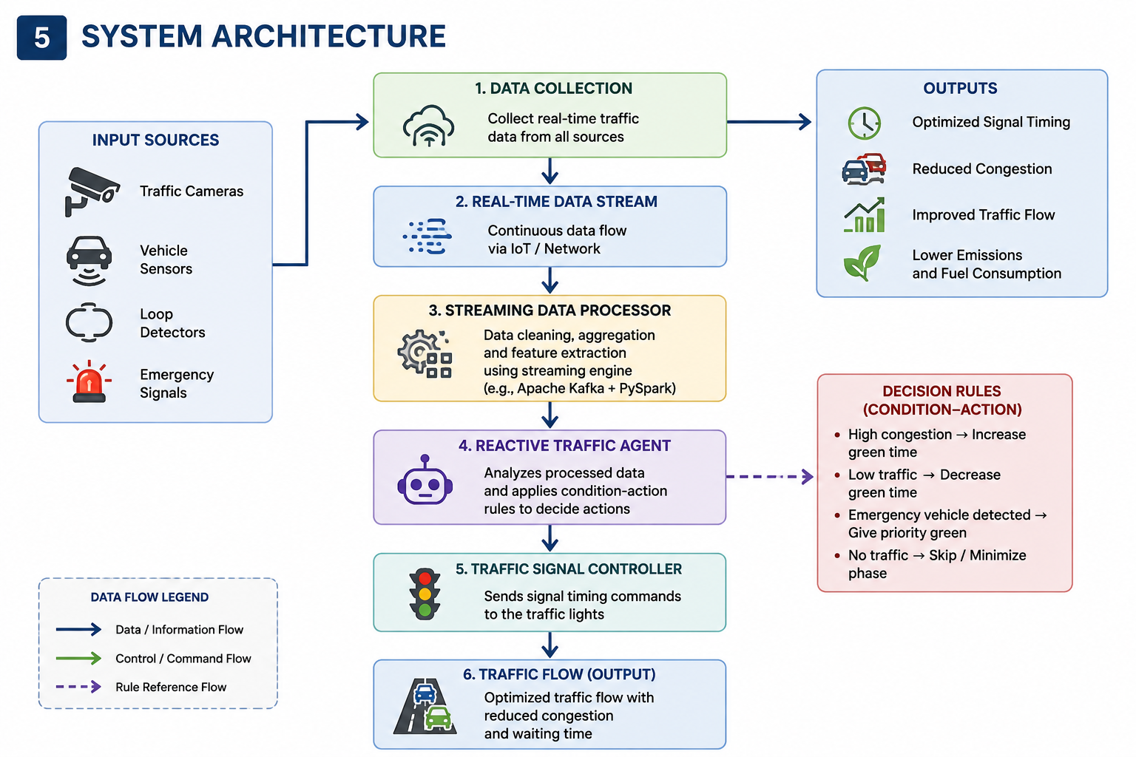
System Architecture

Slide 6
Real-Time Data Processing
Example
If the sensor detects:
Lane A → 80 vehicles
Lane B → 25 vehicles
Lane C → 15 vehicles
Lane D → 10 vehicles
The agent identifies Lane A as highly congested and dynamically increases its green-light duration.
Streaming Traffic Data
The system continuously receives traffic information from sensors and cameras.
Pipeline Processing:
Data Collection → Data Cleaning → Real-Time Analysis → Agent Decision → Signal Update

Slide 7
Dynamic Signal Management
Agent continuously monitors traffic density.
Adjusts green-light duration based on traffic conditions.
High traffic → Increase green time.
Low traffic → Decrease green time.
Helps reduce queue length and waiting time.
Example: Normal traffic → 30 sec green Heavy traffic → 50 sec green

Slide 8
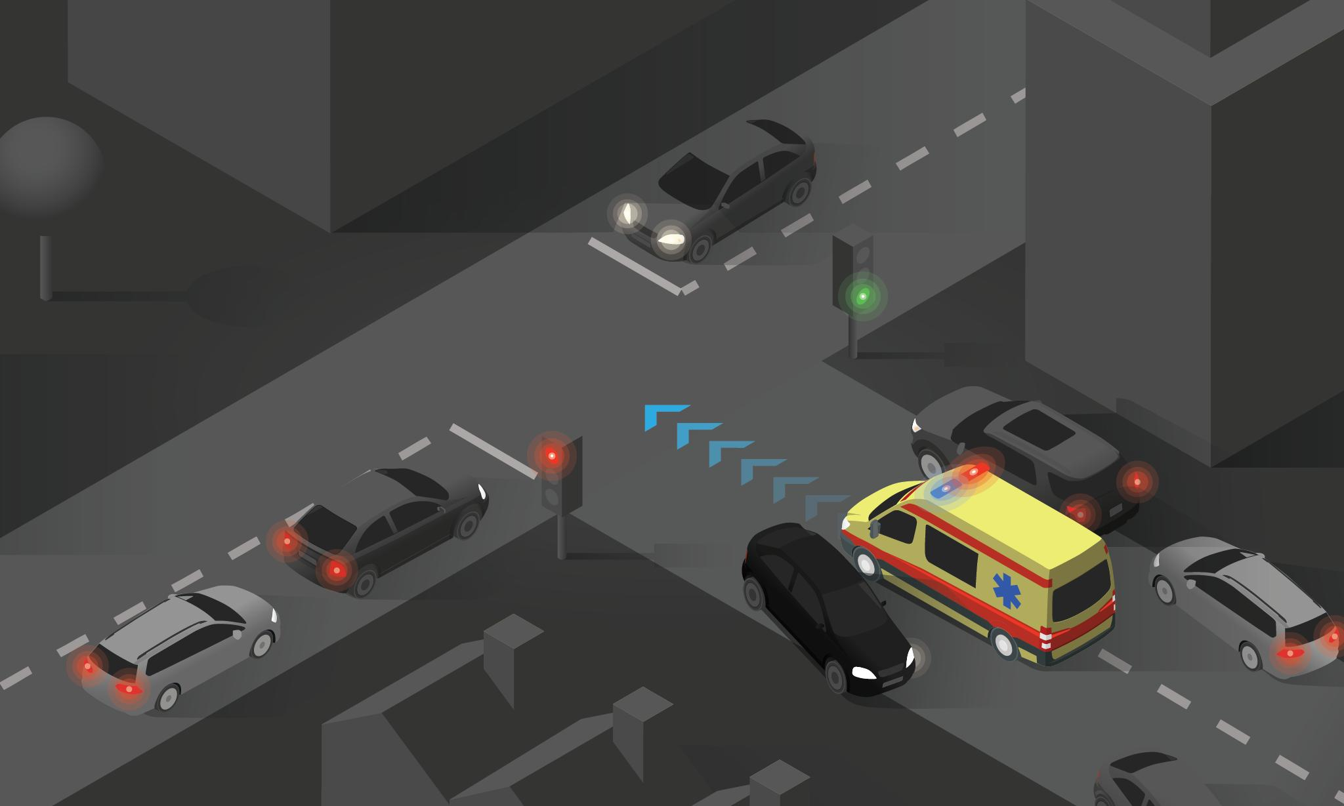
Congestion & Emergency Management
Reduces congestion by giving priority to heavily crowded lanes.
Minimizes average vehicle waiting time.
Detects emergency vehicles in real time.
Emergency vehicle detected → Priority green signal.
After the vehicle passes, the system returns to normal operation.

Slide 9
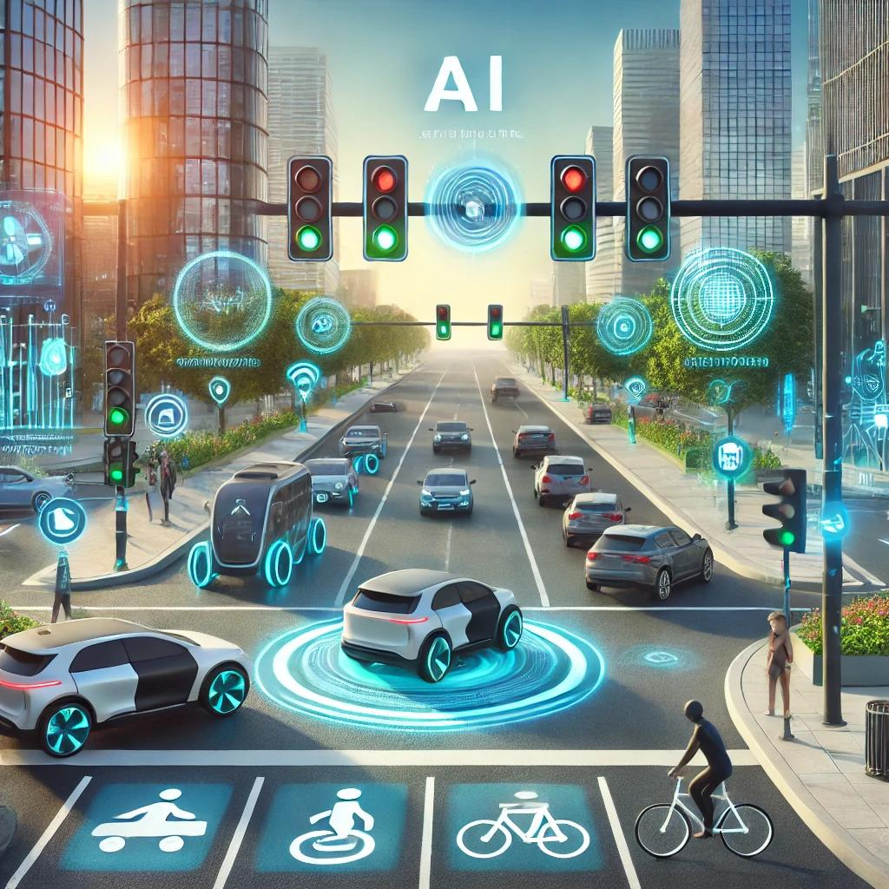
Conclusion
A Reactive Agent provides fast and automatic traffic control.
Real-time streaming data allows continuous monitoring of traffic conditions.
Condition-action rules enable immediate signal changes.
Dynamic signal management helps reduce congestion and waiting time.
The system can serve as a foundation for AI-powered smart city traffic management.

Slide 10


